Slide 1
Communication
Recap exam
Koen Van Eyken
Charlotte Binnemans

Slide 2
Evaluation
In class
Speaking (permanent evaluation) 50%
Presentation 35%
Telephone conversation 15%

Slide 3
Evaluation
Results are not transferred if you have to resit your exam.
Both speaking and writing will need to be done again.
Passed for speaking but failed writing (or vice versa) and total is less than 10? EVERYTHING needs to be done again!
Example:
Evaluation | Grade
Telephone conversation | 9/15
Presentation | 16/35
Written exam | 10/50
Total | 40/100 → 8/20
→ all evaluations must be done again (telephone conversation + presentation + written exam)

Slide 4
Evaluation
During the exam period
Writing (exam) 50%
Professional communication
Planning
Defending your pov
Sales & negotiations
International, multicultural meetings + meeting minutes
Telephone conversations + online meetings & tools
Conflict management
Writing

Slide 5
Study material
PowerPoint presentations.
Your own notes.
Everything that was said and practiced in class is also part of the study material!!!
Actively participating in class.

Slide 6
Exam preparation
Types of questions
Multiple-choice questions
Open-ended questions
Insight questions
Reflection questions
Knowledge questions
Grammar
Spelling
→ knowledge, application, insight
→ understanding the course

Slide 7
Exam preparation - knowledge
Knowledge = studying and understanding
Why is documentation important in negotiations?

Slide 8
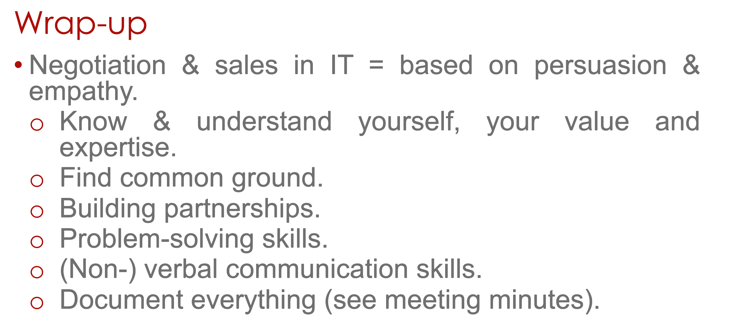
Exam preparation - knowledge
"Why is documentation important in negotiations?"
→ link negotiations + meeting minutes
→ write in full sentences!!
→ you have to understand and explain in your own words what we've seen, don't just study by heart without understanding it!

Slide 9
Exam preparation - knowledge
In which quadrant of the Eisenhower Matrix would this situation fall: you are going on a business trip next month. Your visa has expired and you need to get a new one, waiting time is approximately 3 weeks.
Explain what a BATNA is.
Which Thomas Kilmann style would be most appropriate in this situation?
Two students argue about code formatting, but it won’t affect the project grade. You need to focus on more pressing matters.

Slide 10
Exam preparation - application
Application = applying the theoretical knowledge on real-life scenario's.
An international team of software developers struggles with miscommunication during meetings, leading to missed deadlines and unclear requirements. Explain how active listening and inclusive communication can improve collaboration and explain how digital meeting tools can support these strategies.

Slide 11
Exam preparation - insight
Insight = thinking critically, form links between several topics, reflect.
When working in international teams, should individuals adapt their communication style to fit the dominant culture or should companies encourage diverse communication styles? What are the benefits and challenges of each approach?

Slide 12
Exam preparation
Spelling, grammar, sentence structure etc. is always evaluated!
Always write in full sentences.
Phrases and vocabulary needs to be studied as well.
Please remember: this is a course taught in English, not a course on learning English as a language.
Speaking/writing English well does NOT mean you will automatically pass.
Your other courses are taught in Dutch, you also don't automatically pass them because you speak Dutch. It's the same for Communication.

Slide 13
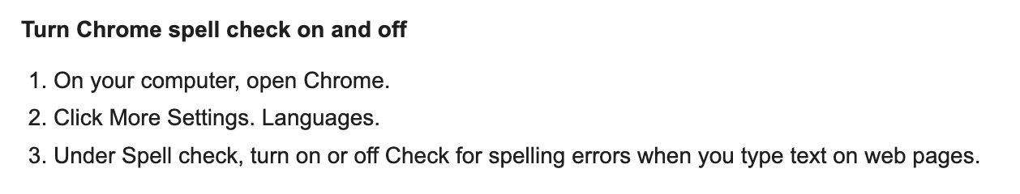
Exam – important information
Spell check, grammarly, copilot, GenAI, … = turned off.
Turn it off in your browser.
Still on = fraud!
NOTHING is allowed to be used.

Slide 14
Exam – important information
Language facilities?
Alinea allowed?
ONLY if you have an official certificate of AP!!

Slide 15
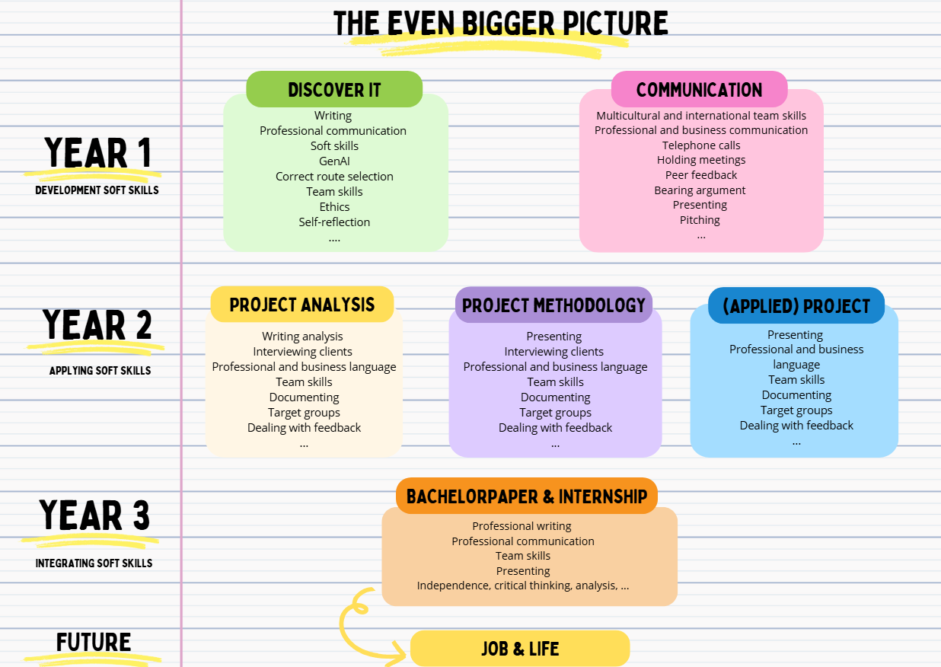
Communication?

Slide 16
Questions?

